Slide 1
Capstone Project 1
Play Store App Review Analysis
By- Saugata Deb Harshad Savle Prasoon Kumar

Slide 2
Contents
Introduction
Objective
Problem Statement
Description of data
Cleaning the data
Exploratory analysis and visualizations
Sentiment analysis
conclusion

Slide 3
Introduction
Android is the most popular operating system in the world, with over 3 billion active users spanning over 190 countries.
Google Play was launched on March 6, 2012, bringing together Android Market marking a shift in Google's digital distribution strategy .
Lots of designers and developers work on it to make an app successful on the Play Store.
There are more than 5 million apps found on Google Play Store.
.

Slide 4
Objective
The main objective of this Project is to gather and understand customer demands better and help developers to make their Apps better and popular on the Play Store

Slide 5
Problem Statement
1.What are the top categories on Play Store?
2.Are majority of the apps Paid or Free?
3.How rating is important for an application?
4.Which categories from the audience should the app be based on?
5.Which category has the most no. of installations?
6.How does the count of apps varies by Genres?
7.How does the last update has an effect on the rating?
8.How are ratings affected when the app is a paid one?
9.How are reviews and ratings co-related?
10.What is Sentiment Subjectivity

Slide 6
Problem Statement
11.How Subjectivity and Polarity proportional to each other?
12.What is the percentage of review sentiments?
13.How is sentiment polarity varying for paid and free apps?

Slide 7
Description of Dataset
There are two dataset: Play Store Data & User Data
1.Play Store Data
App - Name of the Application
Category - Category of the Application
Rating - Rating given to the Application
Reviews - No of reviews given to the Application
Size - Size of the Application

Slide 8
Description of Dataset
Installs - No of downloads of the Application
Type - Free or Paid
Price - Price of the Application if it is paid
Content Rating-It is Age appropriate or Not
Genres - Type of Genre the Application belongs to
Last Updated - When the last time the Application is Updated
Current Ver - Current version of the Application
Android Version- Minimum Android version required to run the Application

Slide 9
Description of Dataset
2)User Review Data:
App – An app name
Sentiment – Sentiment given to an app by users ( i.e. Positive, Neutral, Negative)
Sentiment Polarity – The polarity of sentiment measures how negative or positive the context is. In the data we have, the polarity ranges from +1(Positive) to -1(Negative).
Sentiment Subjectivity - The subjectivity of a sentiment is how likely that sentiment is to be based on data or factual information, versus personal opinions or public notions

Slide 10
Data Cleaning
Data cleaning not just means removing the incorrect data or erroneous data. Many times we get the data which has all kinds of values some of them will cause problems during the analysis of the data and make our predictions incorrect. So we have to make sure our data has no erroneous values.
Data Cleaning Step:
Removing unwanted Values : Deleting of duplicate/incorrect or irrelevant values
Handling Missing Values: Handling missing values in our Dataset
Handling Structural Errors: Fixing mislabelled categories or classes, Typos, Strange name conventions
Filtering Unwanted Outliers: Removing incorrect or unwanted outliers

Slide 11
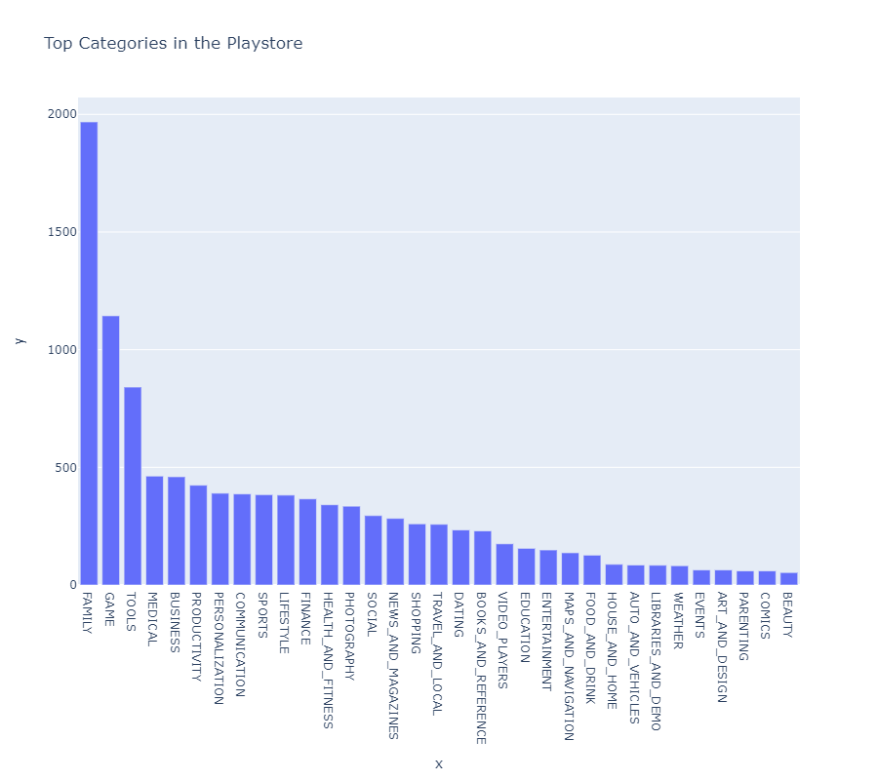
Data Analysis & Visualization
In this part we have created a bar plot which shows no of Apps present play store based on each category
Here we can see that highest number of apps present play store are from Family
Category
The top 5 categories are Family, Games, Tools, Medical, Business

Slide 12
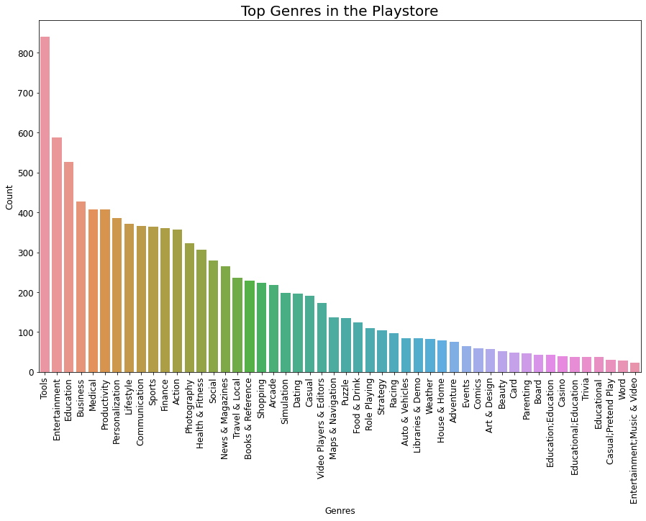
Data Analysis & Visualization(Cont..)
From plot we can find that most of the apps that are developed are in Tools Genre.
Also from above we can observe from above plot that least applications were developed under App Genre Entertainment, Music & Video
Also top 5 Genres are Tools, Entertainment, Education, Medical and Business.

Slide 13
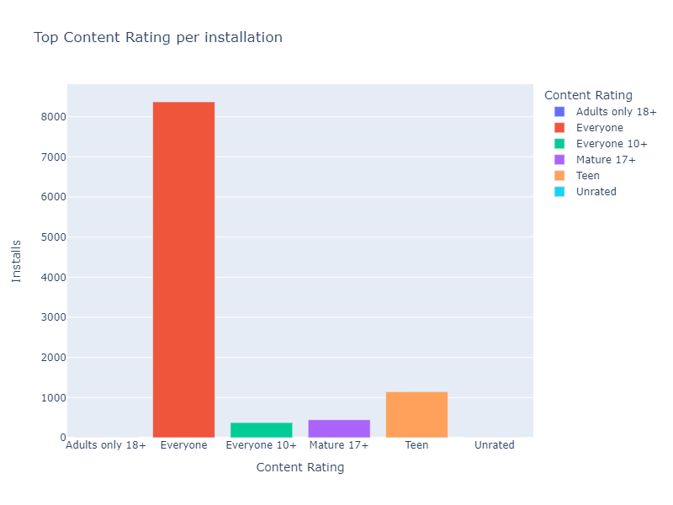
Data Analysis & Visualization(Cont..)
From the bar plot we can observe that users are installing most apps which can be used by everyone
We can also observe that there no apps installed which have content rating 18+

Slide 14
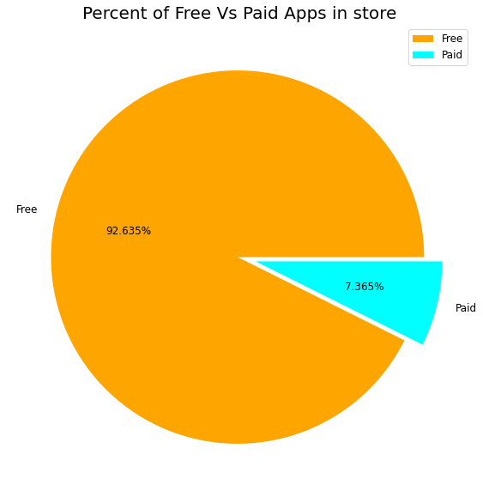
Data Analysis & Visualization(Cont..)
From this chart we can observe that most of the apps present in the play store are free to download
There very less no of apps which are paid

Slide 15
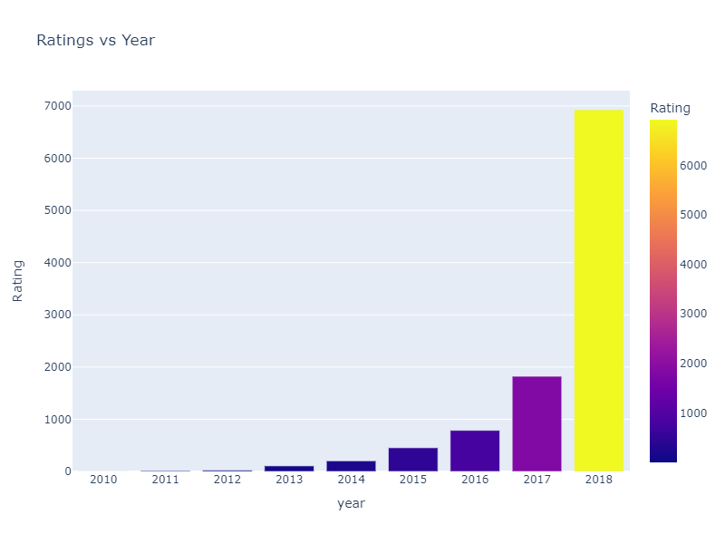
Data Analysis & Visualization(Cont..)
From this we can understand that the no ratings are increasing with every year

Slide 16
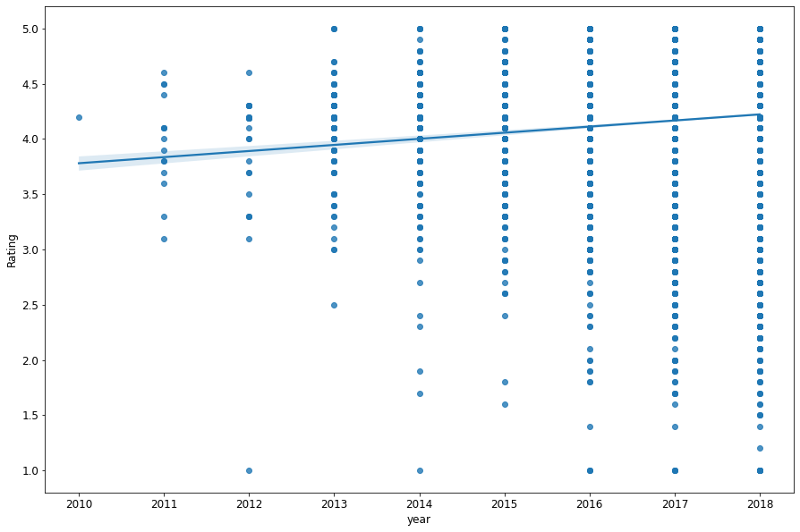
Data Analysis & Visualization(Cont..)
From this graph from matplotlib and seaborn we can conclude that rating is increasing in a proportionate manner with the last updated time. So from this we can be sure that with the latest update the reviewers are giving better rating.

Slide 17
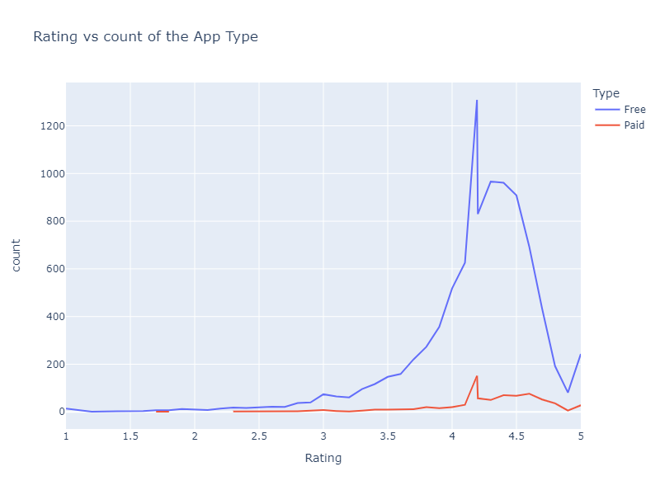
Data Analysis & Visualization(Cont..)
From the graph using plotly we can conclude that the Free Apps has got more rating in terms of number of number of rating. From this we can also see that users of free App are way higher then those users of paid App.

Slide 18
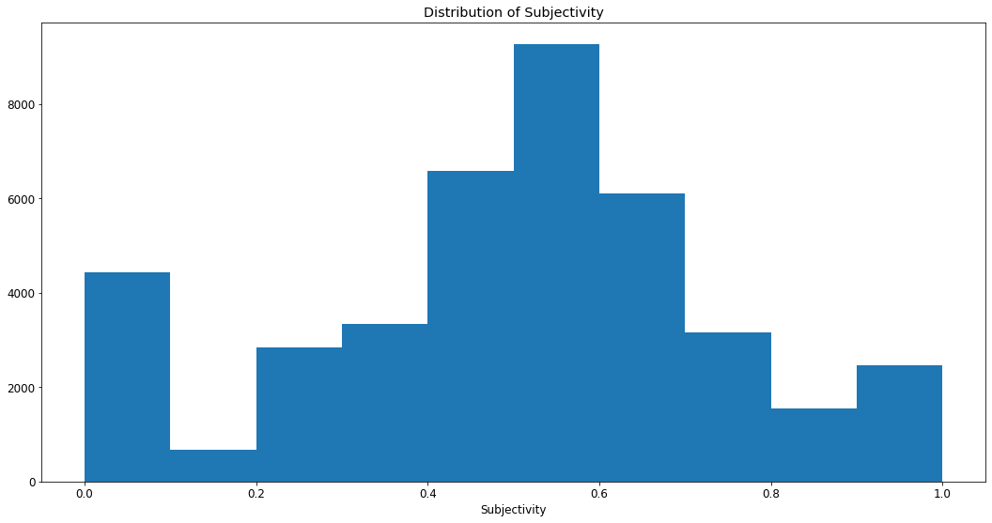
Data Analysis & Visualization(Cont..)
It can be seen that maximum number of sentiment subjectivity lies between 0.4 to 0.7. From this we can conclude that maximum number of users give reviews to the applications, according to their experience.

Slide 19
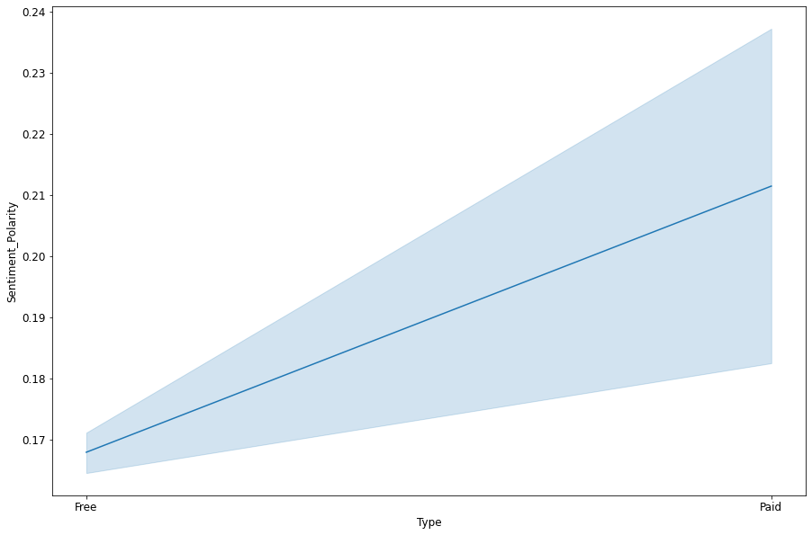
Data Analysis & Visualization(Cont..)
From the above line plot we can conclude that with increase in sentiment polarity ,the sentiment polarity for the paid app is higher than the sentiment polarity for free app. This means people has more sentiment towards paid App than free App.

Slide 20
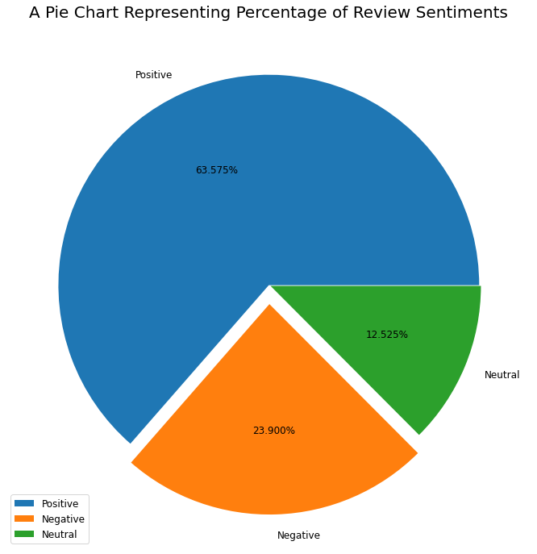
Data Analysis & Visualization(Cont..)
From this pie Chart we can conclude that most of the sentiment reviews given by the user are positives with 63.625%. But also there is a negative sentiment percentage of 24.976% which is higher than the one with the neutral sentiments with 11.399%. This means app developers needs to convert more negative sentiments to neutral or positive sentiments with their Hard work

Slide 21
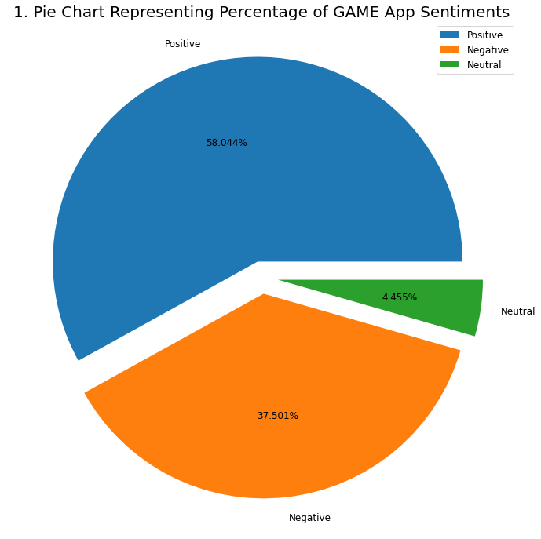
Data Analysis & Visualization(Cont..)
Most negative sentiments from the top translated app category has been received by GAME CATEGORY THIS shows that even if GAME app has the highest translated reviews but in positive sentiment it is low.

